Slide 1
Road Safety Awareness
Edition: November 2021

Slide 2
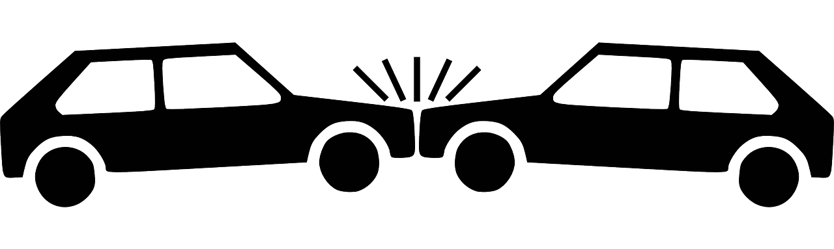
Road Safety Awareness
Aim & Objective
Our aim is to reduce the number of road related incidents through ongoing education.
The objective of this presentation is to help you look at the dangers when travelling in a vehicle and/or near to a road:-
When you are a passenger in a vehicle
When the airbag goes off
When you become distracted
When you are walking along and/or crossing the road
When using ‘powered transporters’ such as e-scooters
The presentation will also cover:-
Why it is essential to wear seatbelts at all times whilst travelling

Slide 3
Road Safety Awareness
Facts & Figures
Did you know:-
Every 22 minutes someone is killed or seriously injured on UK roads ^{Brake}
The last national figures (2020) showed that car occupants accounted for 42% of road deaths, pedestrians 24%, motorcyclists 20% and pedal cyclists 10% ^{Brake}
In 2020 figures show 20% of passengers who died or were seriously injured in a car were aged 11 to 15 years old ^{DFT Annual Data}
Children under the age of 16 are one of the most vulnerable road users, in particular pedestrians, which accounts for the majority of child casualties (around 20%) ^{DFT Annual Data}
In 2020 there were 460 accidents involving e-scooters, which resulted in 484 casualties and 1 death ^{DFT Annual Data}

Slide 4
Road Safety Awareness
Seatbelts

Slide 5
Road Safety Awareness
Seatbelts
Did you know:-
In a road traffic collision…
A seatbelt is designed to stop you tumbling around inside a car
A unrestrained person will continue to move forwards at the speed the vehicle is travelling if not wearing a seatbelt (Newton's First Law)
When sensing a collision, a seatbelt will lock in place and exert a force against the person moving forwards, causing a controlled deceleration (Newton's Third Law)
A back seat passenger not wearing a seatbelt is likely to cause seriously harm or kill the front seat driver or passenger as they get catapulted at speed towards them from the back of the car

Slide 6
Road Safety Awareness
Seatbelts
‘Seatbelts - Julie’ by THINK! Road Safety | Link to YouTube video: youtu.be/lw2aevh6oZ8

Slide 7
Road Safety Awareness
Seatbelts
QUICK QUIZ!
Question 1: When did wearing a seatbelt whilst driving became a legal requirement?
Answer: Wearing a seatbelt whilst driving became a legal requirement in 1983
Question 2: What percentage of people died in vehicles not wearing a seatbelt?
Answer: Around 31% of people who died in vehicles are not wearing a seatbelt ^{PACTS}
Question 3: What penalties can a driver face for not wearing a seatbelt and/or carrying a child under 14 without a proper restraint?
Answer: A driver not wearing a seatbelt and/or carrying a child under 14 without a proper restraint is liable for a fine of £500 and three penalty points ^{GOV.UK}
Remember: when travelling in a car wear
a seatbelt, it could save your life!

Slide 8
Road Safety Awareness
Airbags

Slide 9
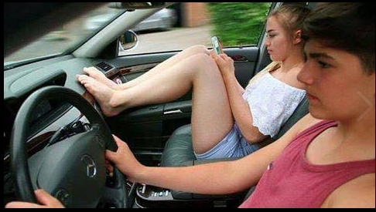
Road Safety Awareness
Airbags
Did you know:-
Airbags are designed to work in conjunction with seatbelts to reduce the chance of your upper body and/or head striking the vehicle's interior
Be aware, if you put your feet up or rest a bag in front of an airbag and the driver has to brake suddenly or is involved in an accident, your knees / bag will be pushed towards your upper body and face
Airbags are deployed at between 100 to 200 miles per hour (MPH)
Remember: airbags are designed to work with seatbelts, not replace them!

Slide 10
Road Safety Awareness
Airbags
This video clip shows one of our training cars with a dummy in the passenger seat. Watch what happens to the dummies foot and leg up on the dash board and how fast it is thrown back…
ACTIVITY
Consider the consequences of your knees / bag being pushed towards your upper body and face at over 100MPH?

Slide 11
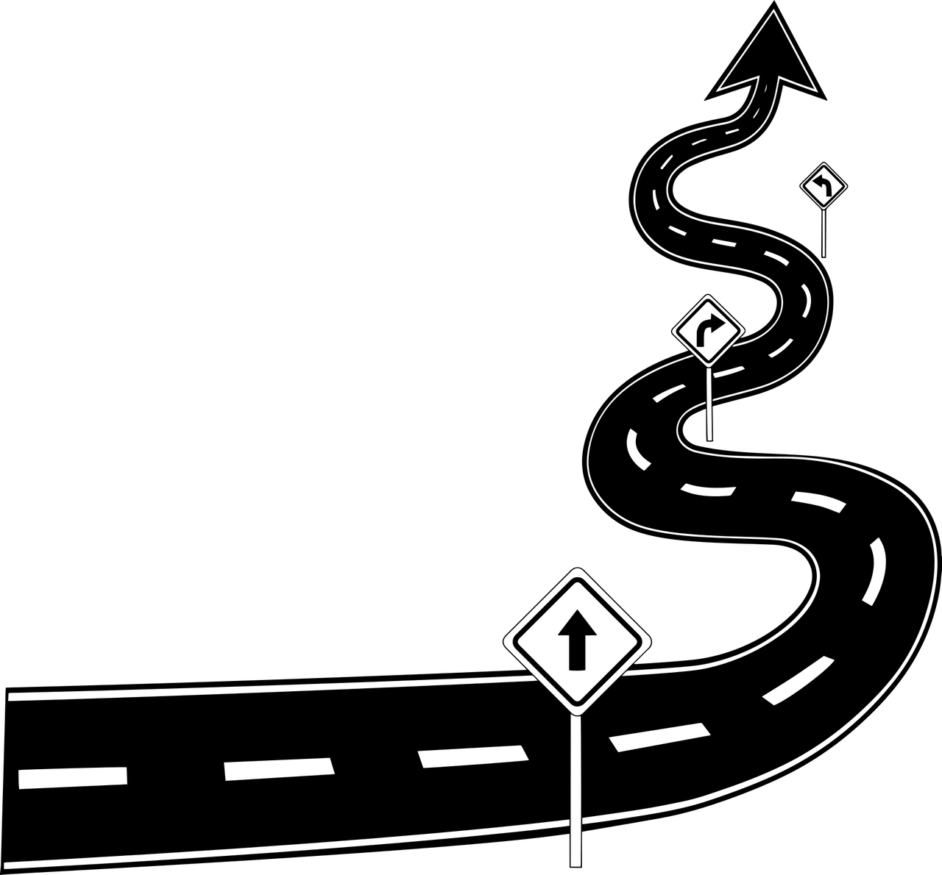
Road Safety Awareness
Airbags
Some of the potential consequences of your knees / bag being pushed towards your upper body and face at over 100MPH :-
Potential (minimal to sever) damage to the face, chest, legs, pelvis and feet
Broken bones
Long term medical complications
Surgery
Death

Slide 12
Road Safety Awareness
E-scooters

Slide 13
Road Safety Awareness
E-scooters
Did you know:-
You can legally use an electric scooter on private land (not accessible to the public) as long as you have permission from the land owner ^{TVP}
It is illegal to use electric scooters on public roads and pavements - you could face a fine and penalty points on your driver's licence, if you have one, and/or your e-scooter could be impounded ^{TVP}
Rental e-scooters can only do a maximum of 15.5mph, you need a provisional licence, insurance provided and are restricted to an allocated area by GPS tracking ^{GOV.UK}
From the 484 casualties involving e-scooters in 2020, 25% were aged 10 to 19 years old - most of those injured received head injuries ^{Road Safety GB}
Helmets are always recommended

Slide 14
Road Safety Awareness
Vehicle Distractions

Slide 15
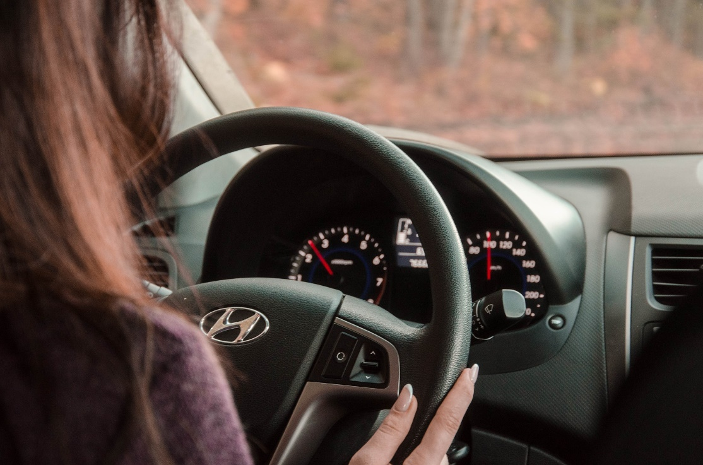
Road Safety Awareness
Vehicle Distractions
Did you know:-
Road accident data suggests that in 2019, ‘distraction in a vehicle’ contributed to 2563 accidents (3% of all reported road accidents) and ‘distraction outside a vehicle’ contributed to a further 1078 accidents (1% of all reported road accidents) ^{ROSPA}
ACTIVITY
Consider the following…
What could happen if a driver were to be distracted whilst driving?
What type of things could distract a driver?
What could passengers do to support the driver in helping to keep them and everyone else safe whilst driving?

Slide 16
Road Safety Awareness
Vehicle Distractions
What could happen if a driver were to be distracted?
The driver will not be looking at the road, which significantly increases the chance of being involved in a crash The driver will not be able to anticipate other drivers actions, such as speed increase/reduction and/or movements e.g. overtaking The driver may not see a pedestrian crossing, a cyclist on the road or an animal up ahead The driver could seriously injure and/or kill themselves and/or other people as a result of their actions
What type of things could distract a driver?
Messaging/texting on a mobile phone whilst driving Having a conversation on a mobile phone whilst driving Loud music Interaction with fellow passengers Adjusting the in-vehicle controls e.g. the radio, satnav, heat controls, etc Eating and/or drinking whilst driving Personal grooming e.g. applying makeup, combining hair, etc Smoking and/or vaping Alcohol and/or drugs
What could passengers do to support the driver?
Remember not to pass or show a mobile phone to the driver and to keep the volume down or on silent, so not to distract the driver Do not lean forwards from the back of the car or block the drivers view Keep your seatbelt on at all times Keep the conversation light and music down to a reasonable level Do not let a person who has consumed to much alcohol or taken drugs to drive
Remember: everyone should take responsibility when in a vehicle

Slide 17
Road Safety Awareness
Vehicle Distractions
Party Car: Crusin’ for a brusin’ by THINK! Road Safety | Link to YouTube video: youtu.be/byLlTSGoK5g

Slide 18
Road Safety Awareness
Pedestrian Road Safety

Slide 19
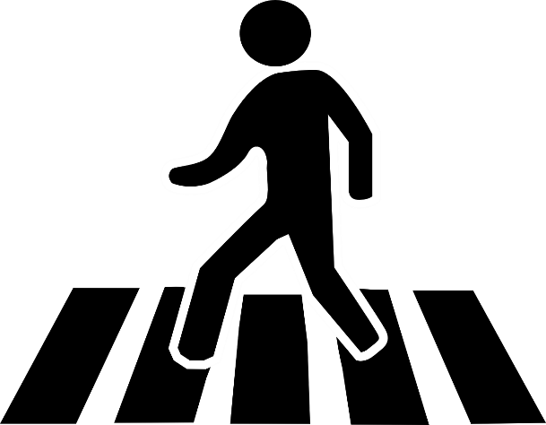
Road Safety Awareness
Pedestrian Road Safety
Did you know:-
24% of road deaths in Great Britain are pedestrians ^{Brake}
In 2020, pedestrian casualty figures show there were 22 deaths and 861 serious injuries relating to children (0-15) ^{Brake}
A 2015 report shows around 55% of children killed or seriously injured during 8am and 8.59am or 3pm and 6.59pm on a school day are pedestrians DFT Facts on Child Casualties 2015
When walking along and/or crossing the road, please remember to :-
Look and listen before you cross - as you approach the place you are going to cross, pause using your mobile and/or take off your headphones
Look at the driver to see if they are looking at you before you cross
Take extra care crossing in between parked vehicles - try to find a safe place to cross the road, look both ways and do not run

Slide 20
Road Safety Awareness
Pedestrian Road Safety
STOP PAUSE LOOK LISTEN Road Safety Campaign | Link to YouTube video: youtu.be/A1w3wLAGFNY

Slide 21
Road Safety Awareness
Cycling Safety

Slide 22
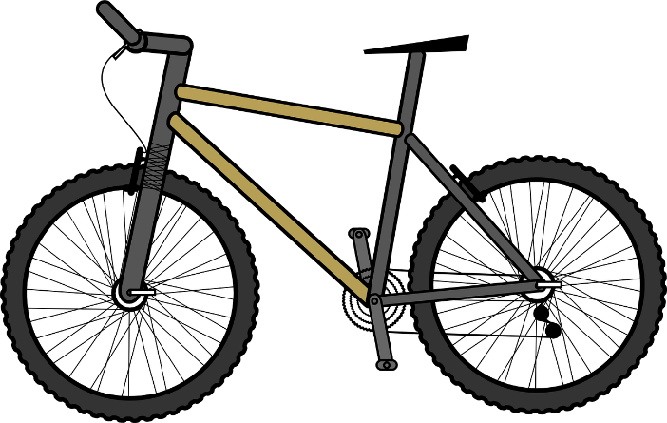
Road Safety Awareness
Cycling Safety
Did you know:-
Every year more than 100 cyclists die on UK roads ^{Brake}
The vast majority of cyclist casualties are from incidents on roads with a 30mph speed limit ^{Brake}
At 30mph, cars travel an average of 23 metres (or 5.75 car lengths) before stopping, where anyone hit by a car travelling at that speed has a 20% chance of dying ^{Brake}
45% of cyclist deaths occur at or near junctions… T-junctions are particularly dangerous ^{Brake}
In 2019, cyclist casualty figures show there were 10 deaths, 462 serious injuries and 1522 slightly injured incidents relating to children (0-15) ^{ROSPA}

Slide 23
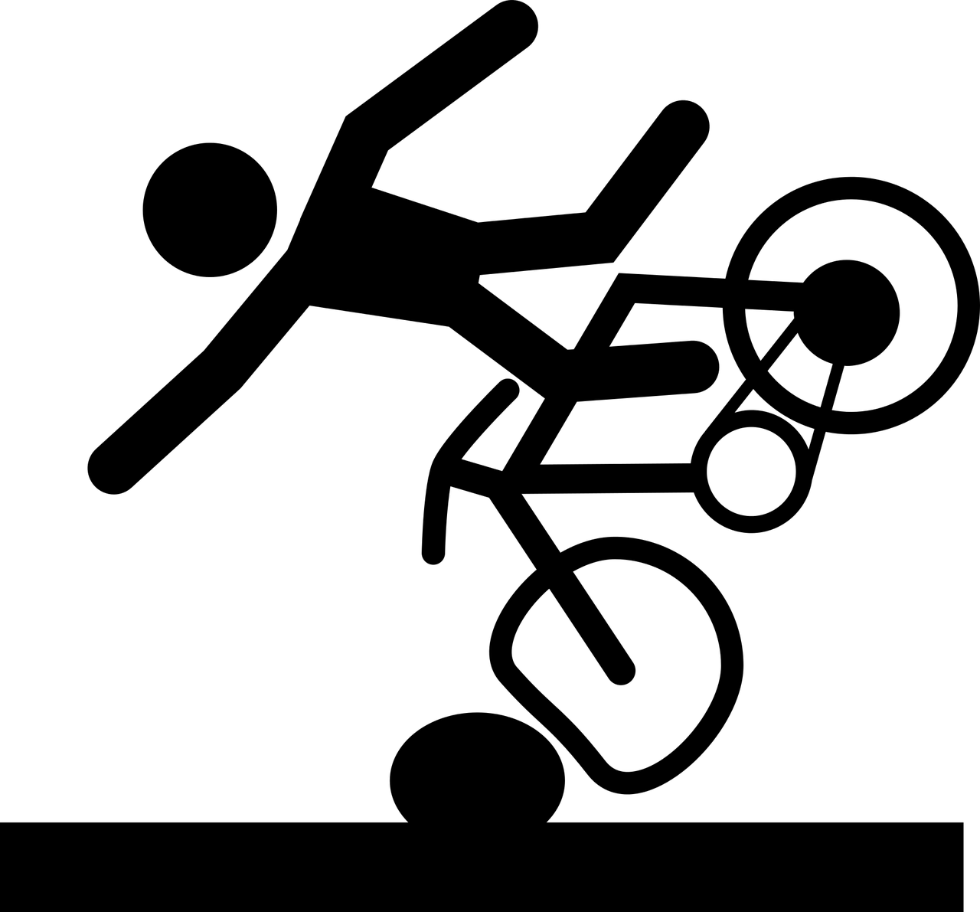
Road Safety Awareness
Cycling Safety
Accidents involving child cyclists are often the result of playing, doing tricks, riding too fast or losing control ^{ROSPA}
Link to BBC article and video: Mother releases 'dangerous game' cycle crash film as warning
Remember: always ride responsibly!

Slide 24
Road Safety Awareness
Cycling Safety
To keep yourself safe when cycling, remember to:-
Wear a helmet and clothes that can be seen, even in the dark
Use lights and florescent strips when cycling at dusk or in the dark
Never use headphones or a mobile phone when cycling
Always make sure to look well ahead for obstructions in the road and behind you for vehicles and other obstacles before turning, overtaking or stopping
Give a clear signals to show other road users what you are going to do
Always take care near road junctions, as other road users might not notice you
Leave plenty of room when passing parked vehicles - watch out for doors being opened and/or pedestrians stepping out into your path
Consider blind spots at the side or rear of large vehicles, as they may not always be able to see you - if you are unable to see the driver in the HGV mirror, then they are unable to see you!

Slide 25
Road Safety Awareness
Cycling Safety
‘Truck driver's blind-spot and cycling’ from the British Safety Council | Link to YouTube video: youtu.be/lV-rhiGRFTE

Slide 26
Road Safety Awareness
Summary
In this presentation we have covered the following to help keep you safe:-
Royal Berkshire Fire and Rescue Service hope you remain safe when travelling in a vehicle and/or near to a road!
For further information, please visit:-
Seatbelts Airbags E-scooters | Vehicle Distractions Pedestrian Road Safety Cycling Safety
Road Safety Additional Information Link: www.rbfrs.co.uk/your-safety/out-and-about/road-safety

Slide 27
Road Safety Awareness
Referenced Organisations

