Slide 1
Water Safety Awareness
Notes:
Teacher’s Note: Introduction to the session.

Slide 2
Water Safety Awareness
Water Safety Aims
The aim of this presentation is to help you look at the dangers within the water if you are preparing to do any of the following:-
Swim in bodies of open water, such as lakes, rivers, canals, seas, quarries, etc
Participate in water sports, such as paddle boarding
Jump into water
Be close to weirs
Visit the coast
The package will also cover:-
What to do if you or someone you are with gets into trouble whilst in the water

Slide 3
Water Safety Awareness
Why is it essential to teach water safety?
Every year several young people drown in water incidents across the UK
The highest risk group is aged 15 to 24
In 2020 nationally, 47 young people aged 15 to 24 lost their lives in a water incident
In a number of cases, young people did not have the knowledge and understanding of cold water shock and the hidden dangers below the surface
By teaching young people how to protect themselves from harm and to take responsibility for their own and others safety when being near to or in the water, we are taking those first, vital steps in keeping young people safe

Slide 4
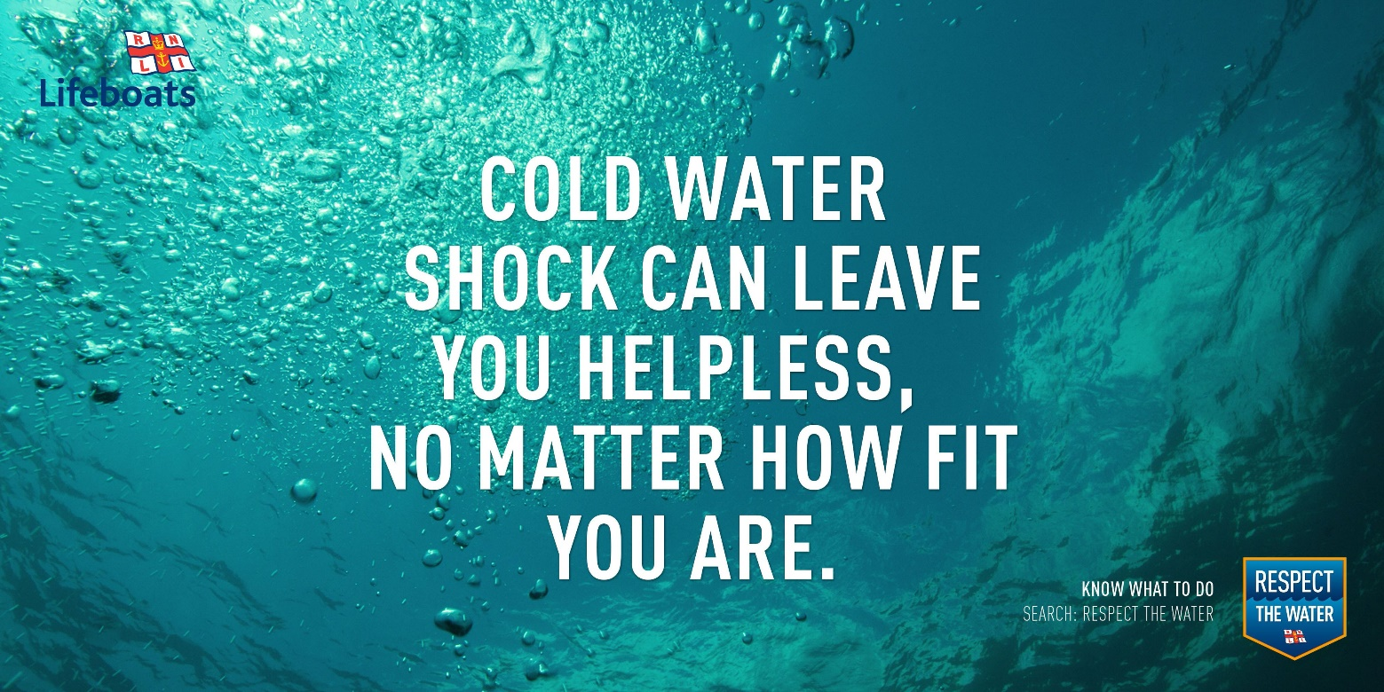
Water Safety Awareness
Cold Water Shock
When you jump into open water, it is much colder than you think!
Cold water shock is the body's involuntary response to being suddenly or unexpectedly immersed into cold water of around 15°C or lower
Any temperature below 15°C is defined as cold water and this will seriously affect your breathing and capability to move
The reactions of the body may be muscle spasms and/or hyperventilation

Slide 5
Water Safety Awareness
Cold Water Shock
Cold water shock can:-
Drastically reduce your ability to hold your breath underwater, roughly from a minute to less than 10 seconds
Induce vertigo, as your ears are exposed to cold water, meaning you cannot tell the difference between up and down
Remember… the water, especially at the coast, can
be even colder than you think!

Slide 6
Water Safety Awareness
Cold Water Shock

Slide 7
Water Safety Awareness
Jumping Into Water (Tombstoning)
When you watch the next clip, please consider how far you would go under the water if you jumped in?
The clip was filmed in a clean swimming pool, which has no weeds, mud or silt at the bottom - all of these could hold you under the water and make it harder to swim
If you were going into open water, would you know how deep it would be in a river or a lake? It may not be as deep as you think!
The water may be fast flowing, not just on the surface but also below
Take a moment to think…
What else could be hiding below?

Slide 8
Water Safety Awareness
Jumping Into Water (Tombstoning)

Slide 9
Water Safety Awareness
Jumping Into Water (Tombstoning)
Watching the clip, the person stepping off the three metre board hit the bottom of the pool, which is 3.5 metres deep
The higher you jump from, the deeper you will go under the water
Is the water deep enough? Some canals and rivers may only be 1 to 2 metres deep!
Think about the water we have around us - it is not clean like in the diving pool and may have things below
In the next two slides you will see examples of things taken out of the River Thames under the Caversham Bridge in Reading… look closely at what was found…
Tombstoning is the act of jumping in a straight, upright vertical posture into a body of water from a high jumping platform, such as a bridge, cliff or harbour edge and is extremely dangerous!

Slide 10
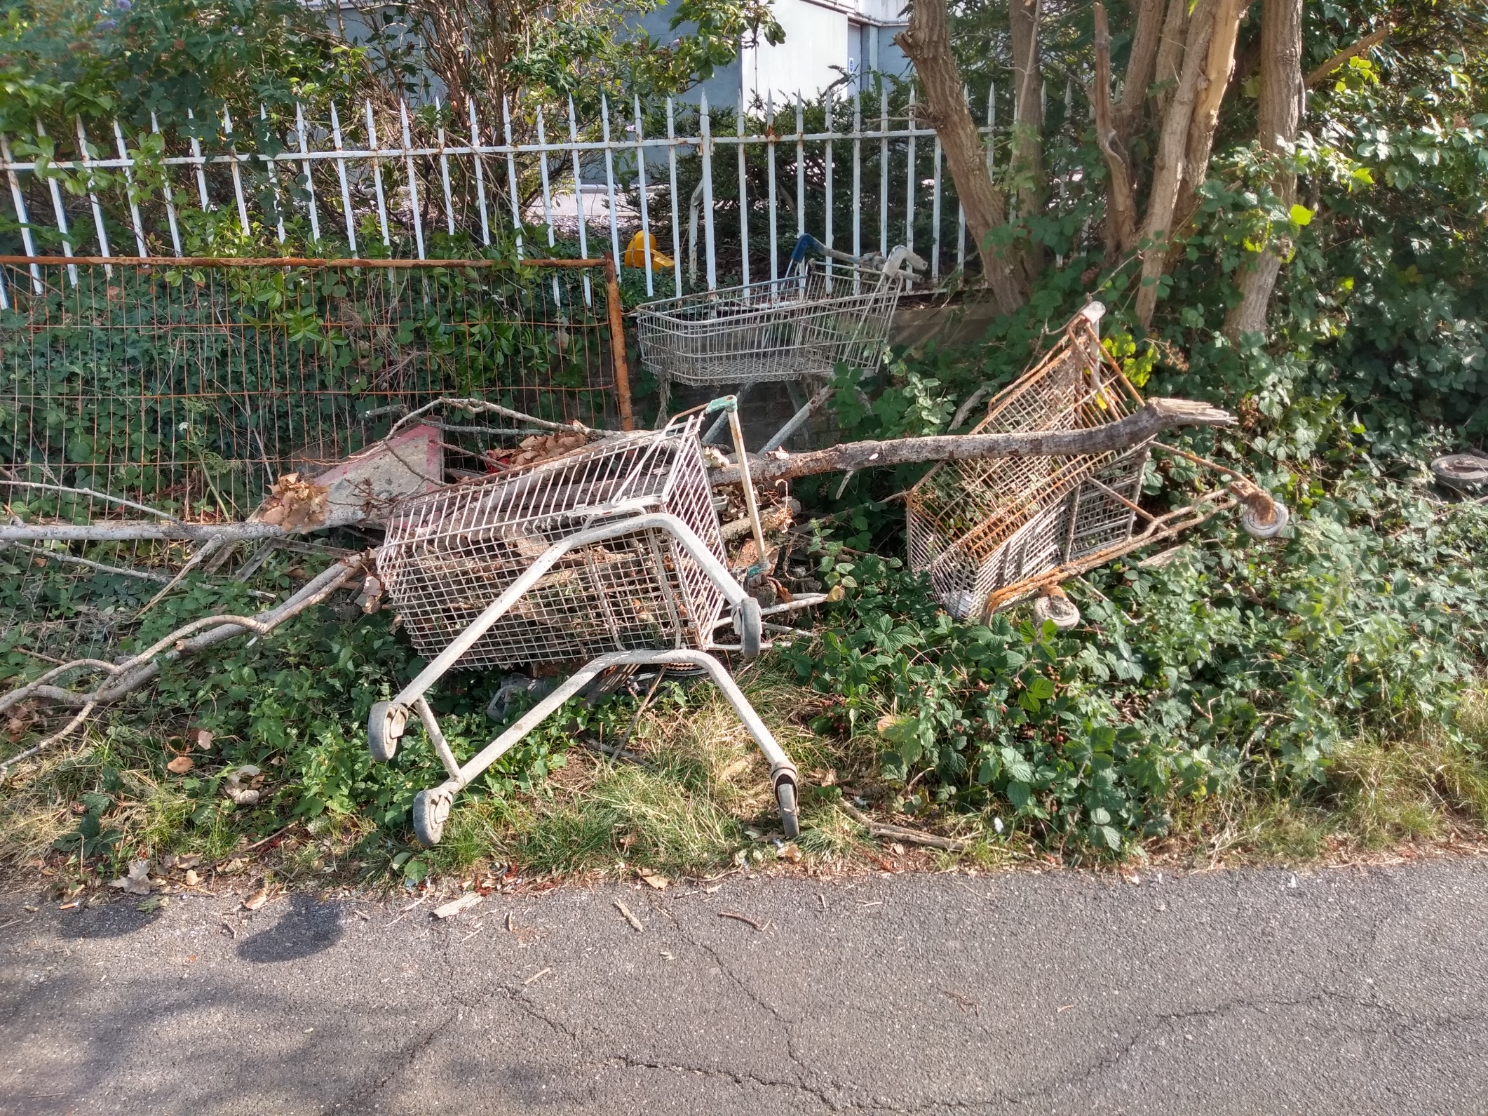
Water Safety Awareness
Hidden Dangers
These items where taken out of the River Thames from directly under Caversham Bridge in Reading

Slide 11
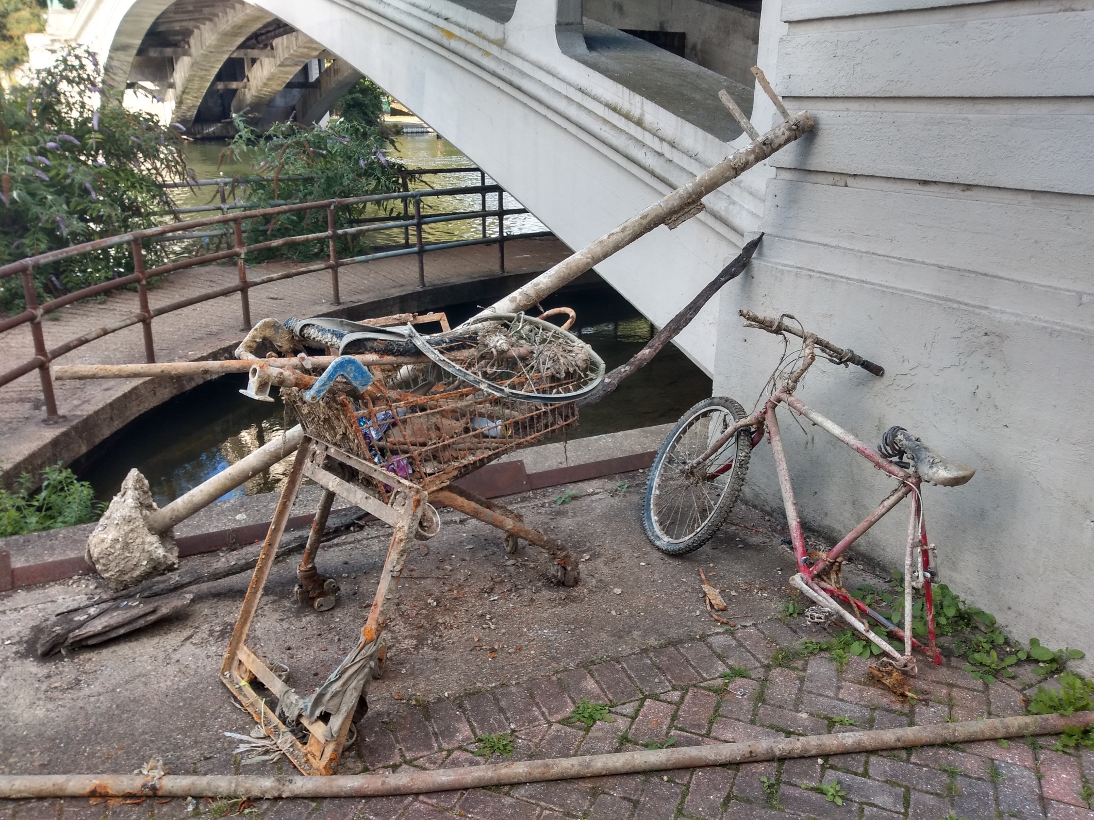
Water Safety Awareness
Hidden Dangers
These items where taken out of the River Thames from directly under Caversham Bridge in Reading
This post was pointing directly upright under the water’s surface

Slide 12
Water Safety Awareness
Hidden Dangers
Now you have seen what may be hidden below the surface, think about the what else you get could get stuck in, for example, weeds, mud or the fast flowing water
We will now watch the dive clip again… please consider:-
The items that came out of the River Thames
The potential effects of Cold Water Shock
Remember a swimming pool…
Has clean, clear water, allowing you to see below the surface
Does not have a current that can sweep people away
Will always display how deep the water is
Is kept at an average temperature of 26°C to 28°C

Slide 13
Water Safety Awareness
Jumping Into Water (Tombstoning)

Slide 14
Water Safety Awareness
Dangers of a Weir
A weir is a barrier across the width of a river or canal that alters the flow of the water, usually resulting in a change to the height of the river level
Even though the water around weirs can often appear relatively calm, they can be extremely dangerous places to boat, swim or wade:-
The water flow around a weir is extremely fast
It is nearly impossible to swim away from a weir, as the water keeps pulling you back and under the water like a washing machine
In the next clip, watch how the footballs keep being pulled back into the weir
Note: in the clip no people are in the weir - only objects being washed along by the flood water

Slide 15
Water Safety Awareness
Dangers of a Weir

Slide 16
Water Safety Awareness
What to do in an Emergency
Call 999 and ask for the Fire Service or the Coastguard if you are at the coast
Give an accurate location, look for identifying landmarks or display boards
If you are using an app to locate yourself, pass on the information to the Emergency Services
Shout loudly for help - someone may be around to help you
Shout to the person - if they can talk, it means cold water shock has passed, so can be encouraged to swim to the side
Use a throwline / life-ring if available or a stick / scarf to pull them to the bank
Never jump in to get them out - cold water shock affects even the best swimmers and you could become a second casualty

Slide 17
Water Safety Awareness
Coastal Dangers
RED FLAG
no swimming at all
Try to swim at a beach with a lifeguard - swim between the red and yellow flags
Make sure you understand and obey any safety flags at the beach
Check the weather and tides before setting out
If possible, avoid swimming alone
Always pay attention to the lifeguards instructions when given
Tell someone where you are going and when you will be back
Inflatable rings or dinghies can be a well-known hazard when using them in open water, a strong wind or current could take you out further than you think
Keep in touch - take some means of communication with you, like a mobile phone or a whistle
BETWEEN TWO RED AND YELLOW FLAGS
safe to swim and belly board
BETWEEN TWO BLACK AND WHITE FLAGS - NO SWIMMING area used by surfers and windsurfers

Slide 18
Water Safety Awareness
Summary
In this presentation we have covered the following to help keep you safe:-
Cold Water Shock
Jumping Into Water (Tombstoning)
Hidden Dangers
Danger of a Weir
Coastal Dangers
Royal Berkshire Fire and Rescue Service hope you remain safe when close to open water… enjoy the summer and stay safe!
For further information and links to different activities, please visit:-
Water Safety Additional Information Link: www.rbfrs.co.uk/your-safety/out-and-about/water-safety

